Slide 1
ASYMPTOTIC NOTATIONS

Slide 2
ASYMPTOTIC PERFORMANCE
  Suppose we are considering two algorithms, A and B, for solving a given problem.
  Running times of each of the algorithms are T_{A}(n) and T_{B}(n) respectively, where n is a measure of the problem size.
  Which is better Algorithm:
    If we know the problem size n in advance and then if T_{A}(n)< T_{B}(n) conclude that algorithm A is better than Algorithm B.
    Unfortunately, we usually don't know the problem size beforehand.

Slide 3
ASYMPTOTIC PERFORMANCE
Asymptotic performance: How does an Algorithm behave as the problem (input) size gets very large?
    Running time
    Memory/storage requirements

Slide 4
ALGORITHMS WITH SAME COMPLEXITY
Represent Complexities of both algorithms in the form of function.
For large value of n (input size ) two algorithms have same complexity, if the functions representing the number of operations have same rate of growth.

Slide 5
ASYMPTOTIC NOTATION
Fortunately, there are asymptotic notations which allow us to characterize the main factors affecting an algorithm’s running time without going into detail
A good notation for large inputs.
The notations describe different rate-of-growth relations between the defining function and the defined set of functions.
Big-Oh O(.)
Big-Omega Ω(.)
Big-Theta Θ(.)
Little-Oh o(.)
Little-Omega ω(.)

Slide 6
ASYMPTOTIC UPPER BOUND-BIG OH
Consider a function f(n) which is non-negative for all integers . Consider another function g(n) also.
We say that ``f(n) is big oh g(n),'' which we write f(n)=O(g(n)), if there exists an integer n₀ and a constant c>0 such that for all integers
0 ≤ f(n) ≤ c .g(n) for all n ≥ n₀

Slide 7

ASYMPTOTIC UPPER BOUND-BIG OH
Let f(n) and g(n) represents complexities of two algorithms.
f(n) is said to be in the family of g(n) iff
0 ≤ f(n) ≤ c .g(n) for all n ≥ n₀

Slide 8
BIG O NOTATION
Example
  If f(n) = 2n²
  g(n) is O(n³ )
Que: Show that f(n) is Big Oh g(n)
Ans: to prove this we have to show that 0 ≤ f(n) ≤ c g(n)
for all n ≥ n₀
If we can find positive constants c and n₀ then we can say that f(n) is big oh g(n)

Slide 9
BIG O NOTATION
Example 1
  If f(n) = 2n² , g(n) is O(n³)
  f(n) ≤ c g(n)
2n² ≤ cn³ ⇒ 2 ≤ cn ⇒ c = 1 and n₀= 2
So, for c=1 and for all n ≥ 2, f(n) is big oh g(n)
There is no unique set of values for n_{o} and c in proving the asymptotic bounds but for whatever value of n_{o} you take, it should satisfy for all n > n_{o}
Or
For c=2 and n_{o =} 4 also, f(n) is big oh g(n)

Slide 10

BIG O NOTATION
Example 2
  If f(n) = 8n+128, g(n) is O(n²)
  To prove f(n) is big oh g(n) we have to prove that
  f(n) ≤ c g(n) for all n ≥ n₀ and constant c
  Lets take c=1
Since (n+8)>0 for all values of n ≥ 0 , so for n₀=16
Above rule is satisfied.
So, for c=1 and for all n ≥ 16, f(n) is big oh g(n)

Slide 11
BIG-O NOTATION
When determining the order of a function f(x), always try to pick the smallest g(x) possible.
If f(x) is Ο(g(x)) and g(x) is Ο(f(x)), then f(x) and g(x) are of the same order.
In practice, all big-O results are obtained for functions that are positive for all values of x.

Slide 12
ASYMPTOTIC LOWER BOUND: Ω-NOTATION
Big O is asymptotic upper bound
Ω-notation is asymptotic lower bound

Slide 13

Ω-NOTATION
A family of functions we say ``f(n) is omega g(n),'' iff
{ f(n) : there exist positive constants c and n_{o} such that
0 ≤ c g(n) ≤ f(n) for all n≥ n₀ }

Slide 14
Ω-NOTATION
Example:
For any two functions f(n) and g(n) we have
f(n) = 5n² -64n+256 and g(n) = Ω(n²)
so, f(n) = Ω(g(n) if and only if c. g(n) ≤ f(n)
Sol: in order to show this we need to find an integer n₀ and a constant c>0 such that for all integers n≥ n₀ f(n) ≥ cn²

Slide 15

Ω-NOTATION
Example:
For any two functions f(n) and g(n) we have
f(n) = 5n² -64n+256 and g(n) = Ω(n²)
suppose we choose c=1, then
So here (n-8)²
Is always positive for all n ≥ 0 so n₀ = 0
Hence for c=1 and n₀ =0 ``f(n) is omega g(n),''

Slide 16
Θ- NOTATION DEFINITION
Θ( g(n) ) denotes a family of functions.
``f(n) is Theta g(n),'' if we can find constants c₁, c₂, and n₀ such that
0 ≤ c₁ g(n) ≤ f(n) ≤ c₂ g(n)
for all n ≥ n₀

Slide 17
For any two functions f(n) and g(n) we have
f(n) = Θ(g(n))
if and only if
f(n) = O(g(n)) and f(n) = Ω(g(n))

Slide 18

ASYMPTOTIC TIGHT BOUND
This is said to asymptotic tight bound.
For reasonably large values of n, the function f(n) is within the range of constant multiples of g(n)
f(n) is bounded below as well as above.

Slide 19
RELATIONS BETWEEN NOTAIONS

Slide 20
Θ- NOTATION
Example
  If f(n) = 7n² – 54n +3
  g(n) is Θ (n² )
Que: Show that f(n) is Theta g(n).
Ans: If f(n) is also having the same running time as g(n) then prove following rule: 0 ≤ c₁ g(n) ≤ f(n) ≤ c₂ g(n)
for all n ≥ n₀
  Now find c₁, c₂ and n₀

Slide 21
  We want c₁, c₂ and n₀ such that
  c₁n²≤ 7n² – 54n +3 ≤ c₂n²
  for all n ≥ n₀
7n² – 54n +3
  Select c₁ < 7 and 7< c₂
  Say c₁ = 5 and c₂ = 9
To get 5n²≤ 7n² – 54n +3,
n must be bigger than 27.
7n² – 54n +3 ≤ 9n² is true for all n.
Thus c₁ = 5, c₂ = 9 and n₀ = 28

Slide 22
TAKE ANOTHER EXAMPLE
If f(n) = 7n³ – 54n² + 10n + 3
  Can g(n) be n² ?
  NO
  c₂n² cannot be larger than n³ for large n.
  Thus you cannot find c₁, c₂ and n₀
  Thus f(n) ≠ Θ (n² )

Slide 23
LITTLE O-NOTATION
o(g(n) ={ f(n):
for any positive constant c > 0 there exists a constant n₀ > 0 such that
0 ≤ f(n) < cg(n) for all n ≥ n₀ }
Limit f/g → 0

Slide 24
LITTLE ω-NOTATION
ω(g(n) ={ f(n):
for any positive constant c > 0 there exists a constant n₀ > 0 such that
0 ≤ cg(n) < f(n) for all n ≥ n₀ }
Limit g/f → 0

Slide 25
NAMES OF MOST COMMON BIG OH FUNCTIONS
Constant O(1)
Logarithmic O(log n)
Linear O(n)
Quadratic O(n²)
Polynomial O(n^{k}) k is a constant
Exponential O(2^{n})
Exponential O(a^{n}) a is a constant and a > 1

Slide 26
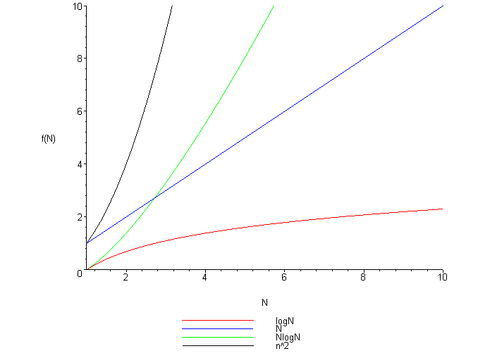

Slide 27
THEOREM
R1: If d(n) is O(f(n)), then ad(n) is O(f(n), a > 0
R2: If d(n) is O(f(n)) and e(n) is O(g(n)), then d(n)+e(n) is O(f(n)+g(n))
R3: If d(n) is O(f(n)) and e(n) is O(g(n)), then d(n)e(n) is O(f(n)g(n))
R4: If d(n) is O(f(n)) and f(n) is O(g(n)), then d(n) is O(g(n))

Slide 28
THEOREM
R5: If f(n) = a₀ + a₁n + … + a_{d}n^{d}, d and a_{k} are constants, then f(n) O(n^{d})
R6: n^{x} is O(a^{n}) for any fixed x > 0 and a > 1
R7: log n^{x} is O(log n) for any fixed x > 0
R8: log ^{x}n is O(n^{y}) for any fixed constants x > 0 and y > 0

Slide 29
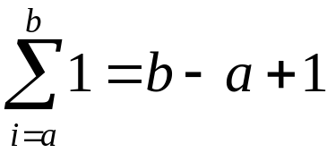
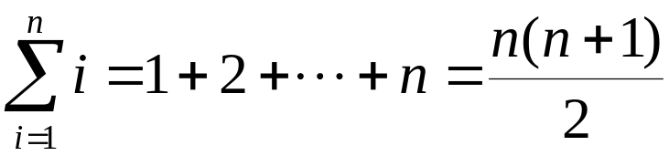
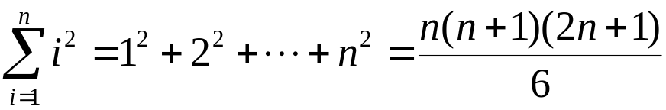
SOME HELPFUL MATHEMATICS
Constant Series: For integers a and b, a ≤ b,
Linear Series (Arithmetic Series): For n ≥ 0,
Quadratic Series: For n ≥ 0,

Slide 30
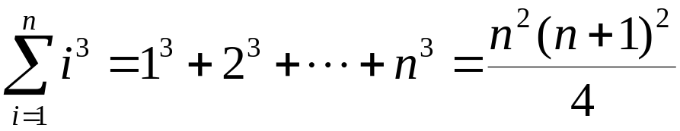
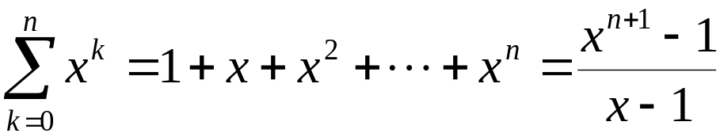
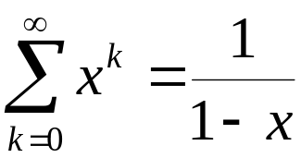
SOME HELPFUL MATHEMATICS
Cubic Series: For n ≥ 0,
Geometric Series: For real x ≠ 1,
For |x| < 1,

Slide 31
SOME HELPFUL MATHEMATICS
Cubic Series: For n ≥ 0,
Geometric Series: For real x ≠ 1,
For |x| < 1,

